Slide 1

CSE499A RESEARCH PROPOSAL

Slide 2

GROUP MEMBERS-
Md. Abdur Rakib Rahat
1620521042
Md. Raihan Hossain
1520566642
Sumaya Yeacin Rimu
1530664042
Anwar Shadaab
1611383042

Slide 3
Topic Name: An Analysis to deremine how e-commerce sites implement their business strategies using the dark web and to examine whether it works differently for regular internet e-commerce sites.

Slide 4
Introduction
The dark web is the World Wide Web content that exists on deep nets , overlay networks that use the Internet but require specific software, configurations, or authorization to access. The dark web forms a small part of the deep web, the part of the Web not indexed by web search engines, although sometimes the term deep web is mistakenly used to refer specifically to the dark web.

Slide 5


Slide 6
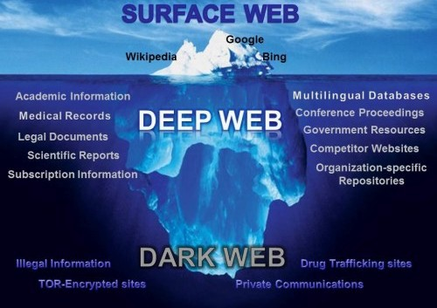

Slide 7
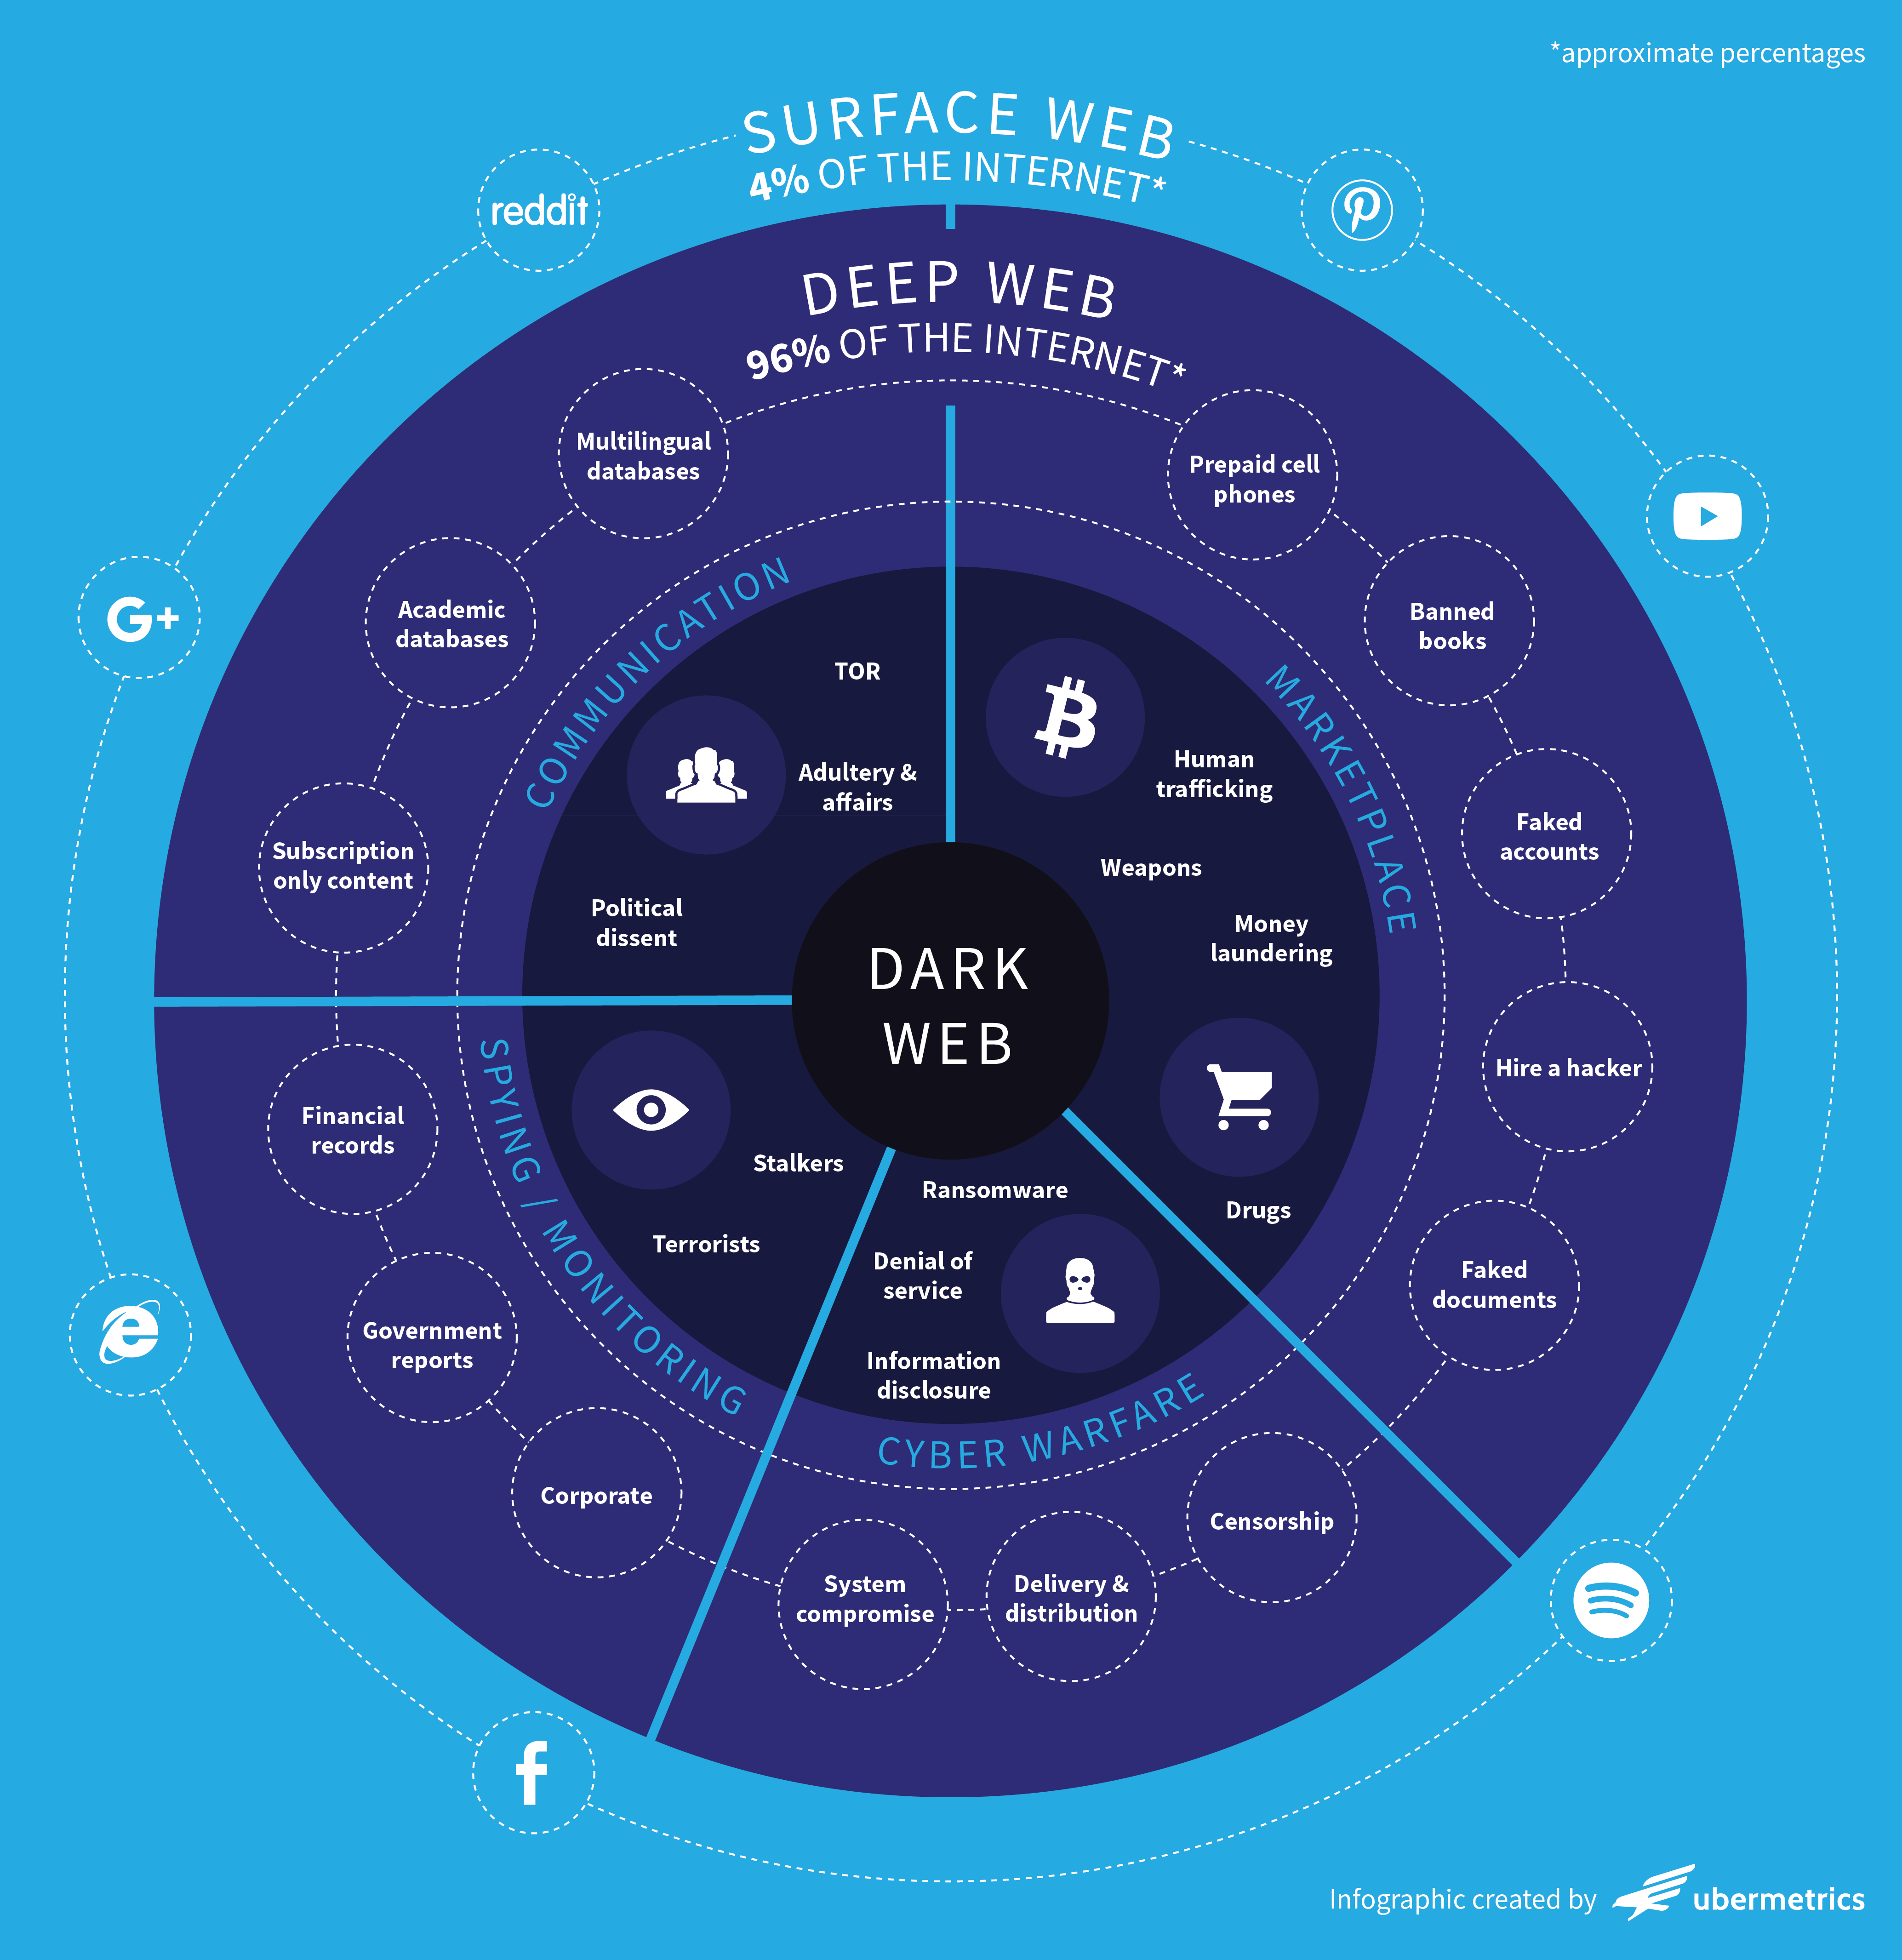

Slide 8
There are plenty of eCommerce sites which sell counterfeit or grey-market goods on the Dark Web. These websites sell anything from pirated content to financial information, to illicit drugs and prescription pharmaceuticals. The now shut down Alphabay, for example, basically operated like eBay.

Slide 9
Literature Review:
Critical Analysis of the Emerging Dark Web .
The core objectives of the research study are:
To find out the activities that helped by the dark web in a positive way & negative way.
To identify the ways those reduce the negative impacts of the dark web & using the dark web in a way that is more constructive.
By Abdulmuttaleb Abduljalil
Department of Computing & Information Systems
Cardiff School of Management
Cardiff Metropolitan University

Slide 10
Literature Review:
Archives for the Dark Web: A Field Guide for Study.
Robert W. Gehl
Here author created a catalog of archives of Dark Web:
Software Repositories
Mailing Lists
Forums
Hidden Sites

Slide 11
Literature Review
The not so Dark-side of the darknet: A qualitative Study
Mihnea Mirea · Victoria Wang · Jeyong Jung
This paper reports on a recent research in four Dark Net forums that reveals a different aspect of the Dark Net.

Slide 12
OVERVIEW:
There are so many e-commerce site in dark net.
Dark net marketplace is the market where one can sell or buy products online. In dark net markets the payment mode where made more secure and clear. The dark net markets contain more products listed under many categories and each market have unique products in it.
Mostly the dark net markets contain drugs, weapons, fraud, pirated versions of software etc.
Here are some dark net markets example with links given below:
http://pwoah7foa6au2pul.onion –
Alphabay market – Here you can buy drugs, weapons, chemicals, etc., This is one of the best marketplaces in the dark net.

Slide 13
OVERVIEW:
http://lchudifyeqm4ldjj.onion/ –
Dream Market – This is the second largest market in the darknet. Here you can buy drugs and digital products.
http://hansamkt2rr6nfg3.onion/ – Hansa Market – It is also another popular deep web marketplace. Here you can buy drugs, weapons, digital products, tutorials, guide etc.

Slide 14
OVERVIEW:
So, at last there are so huge e-commerce sites in dark-web. We actually figure out how they deal with clients of dark-web and what’s the policy of it, and also find out that is it actually beneficial from regular e-commerce site or not. and also find out the strategies between surface-web and dark-web. also which policy they use for transferring currency and how clients get their products.
And are dark webs e-commerce sites structures different from surface web or not and how they program in it? Are they use extra security protocols or not?
For our research, we will use dark web browser, reference paper and google .

Slide 15
THANKS!

